Slide 1
SCRUM in Software engineering
Bardia Nikbakhsh
bardian@ustmb.ac.ir

Slide 2
The term of scrum
The software development term scrum was first used in a 1986 paper by Hirotaka Takeuchi and Ikujiro Nonaka.
in the early 1990s, Ken Schwaber used what would become scrum at his company, Advanced Development Methods; while Jeff Sutherland, John Scumniotales and Jeff McKenna developed a similar approach at Easel Corporation, referring to it using the single word Scrum.

Slide 3
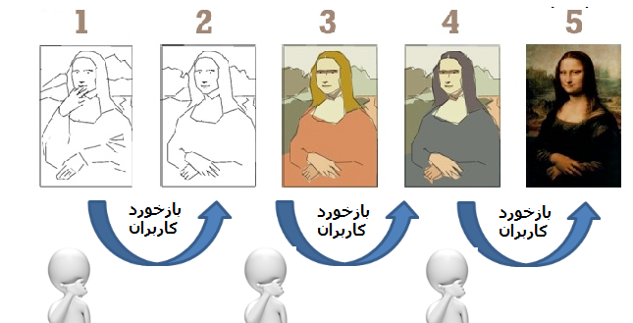
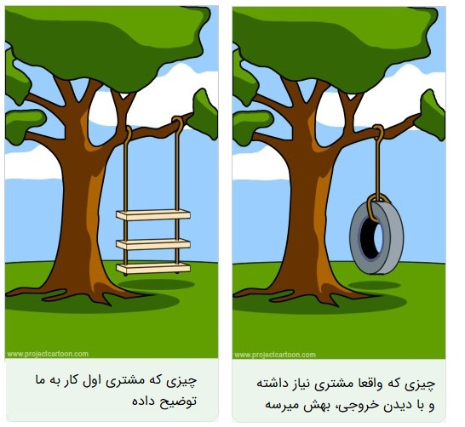
What is scrum?
Scrum is a lightweight, iterative, and incremental framework for developing and delivering complex products.

Slide 4
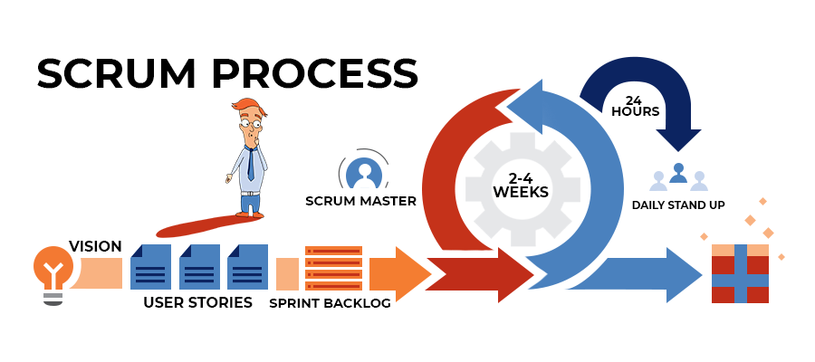
Sprint
A sprint is a short period when a scrum team works to complete a set amount of work.
Scrum projects make progress in a series of “sprints”

Slide 5
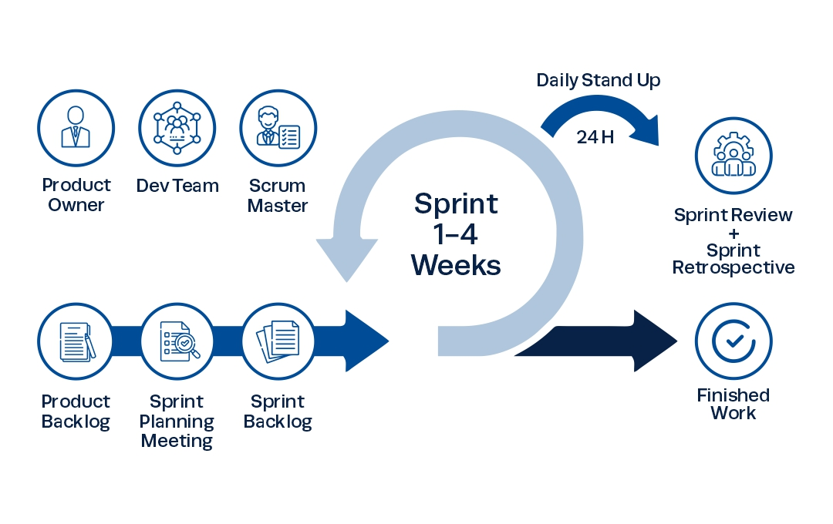
Scrum framework
Roles
Product owner
ScrumMaster
Dev Team
Events
Sprint planning
Sprint review
Sprint retrospective
Daily scrum meeting
Artifacts
Product backlog
Sprint backlog
Burndown charts

Slide 6
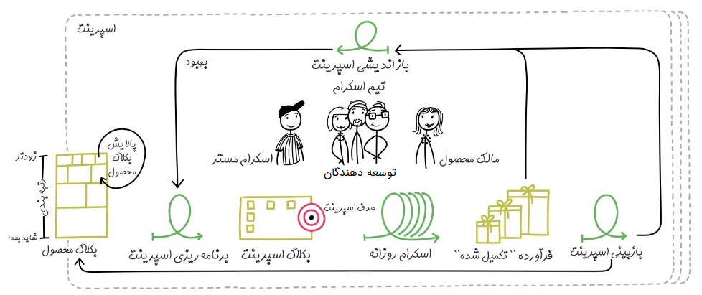
Scrum framework

Slide 7
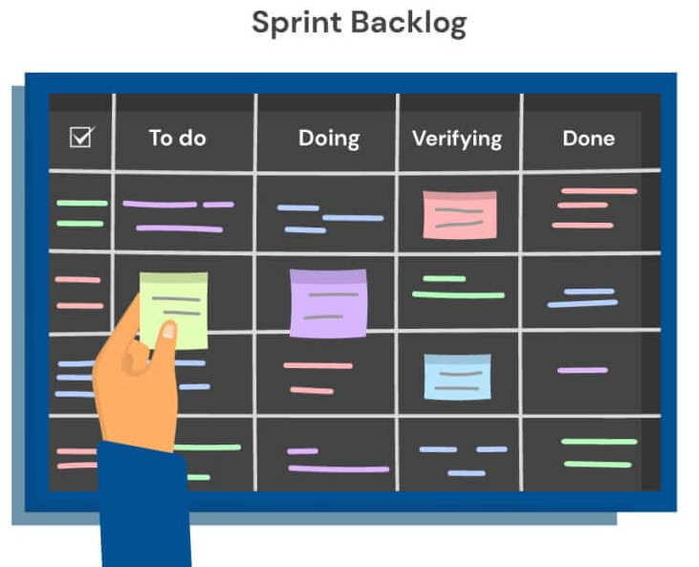
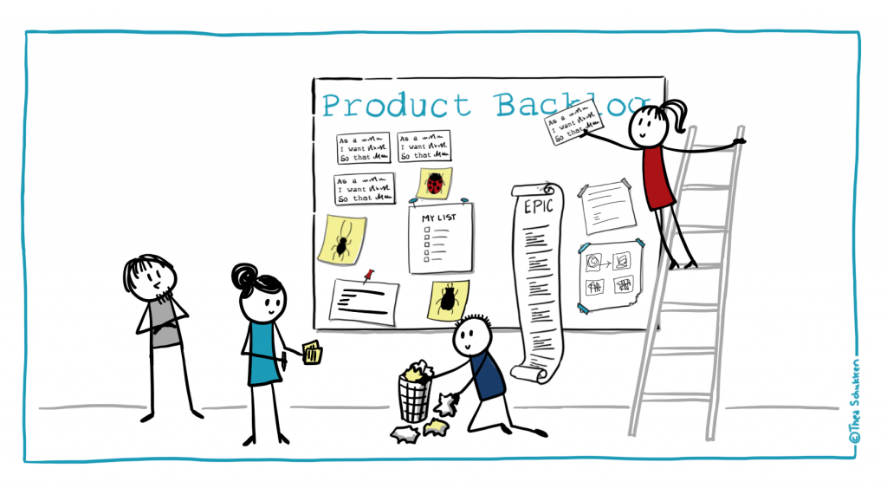
Sprint Backlog & Product Backlog

Slide 8
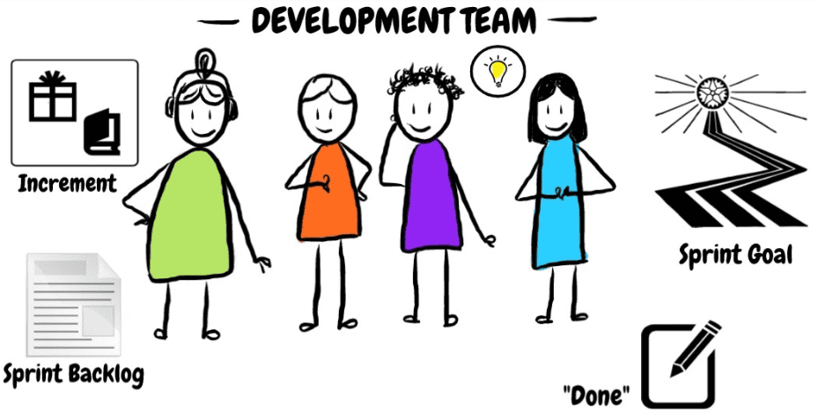
Scrum Dev Team
Self-Organize
Cross-Functional
اندازه مطلوب تیم توسعه آنقدر کوچک است که چالاک باقی بماند و آنقدر بزرگ است تا بتواند کار قابل توجهی را در طول اسپرینت به سرانجام برساند.

Slide 9
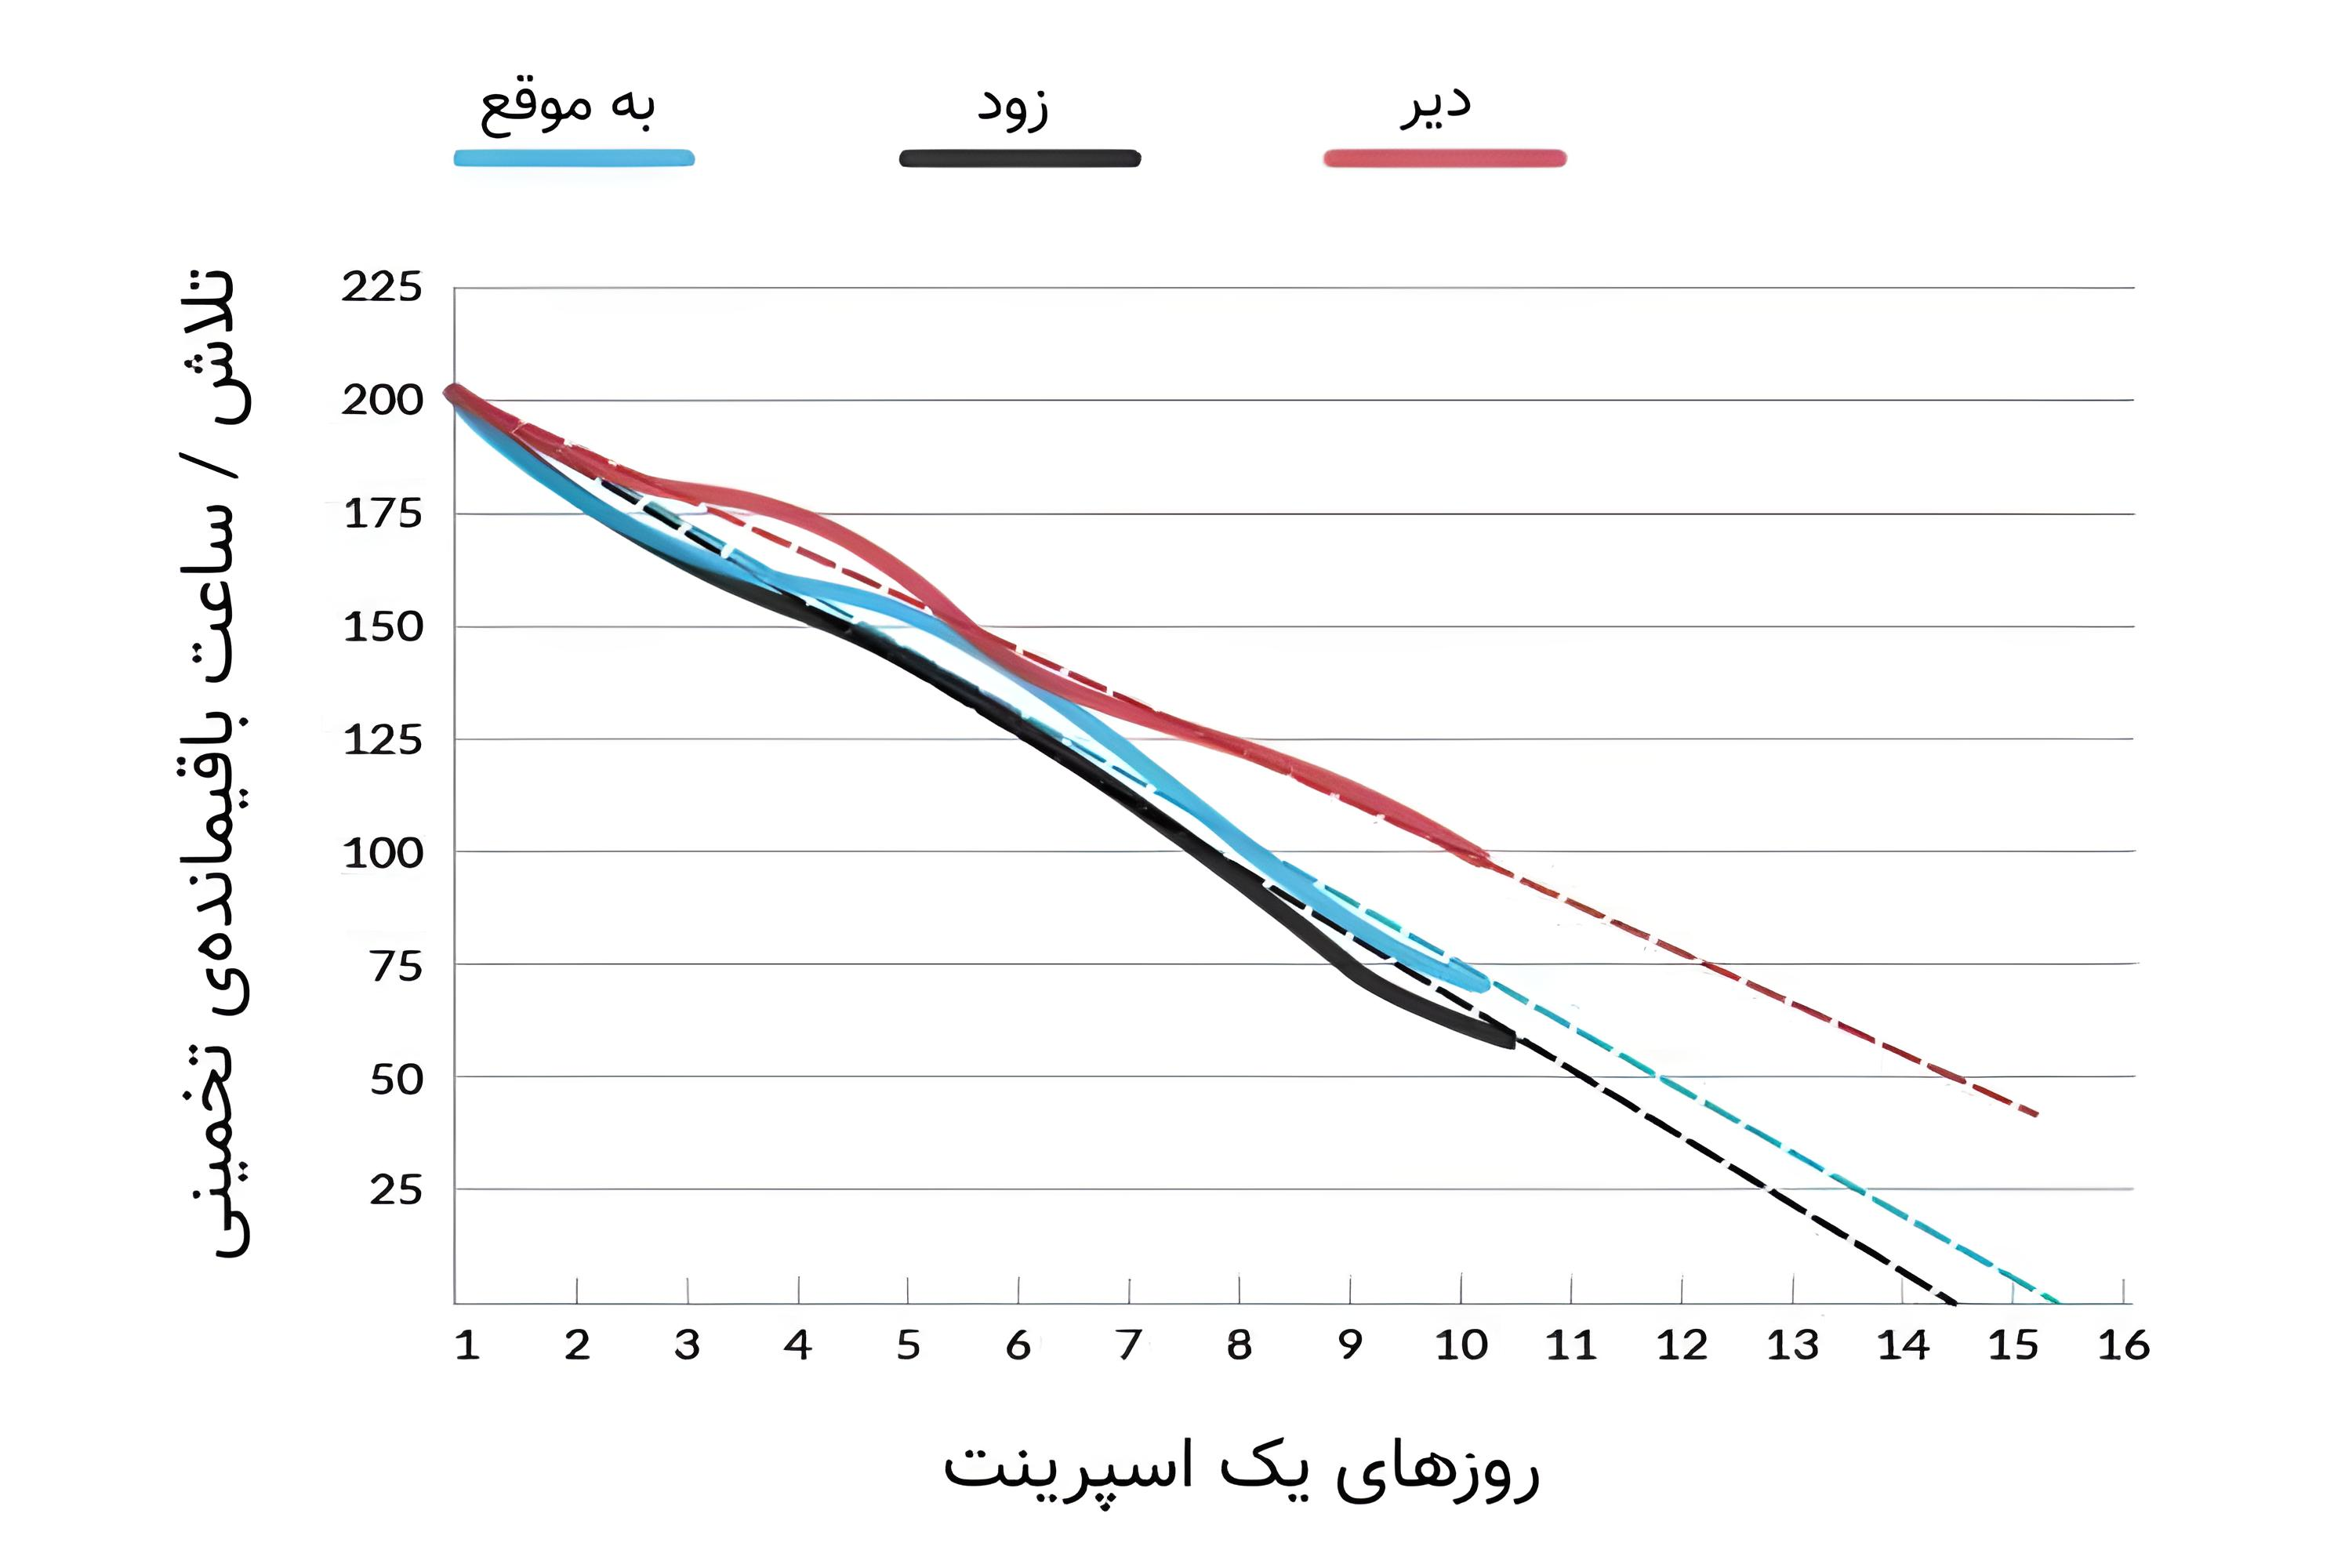
BurnDown
این نمودار نشان دهنده میزان کاری است که تصور می‌شود در backlog باقی می‌مانند.

Slide 10
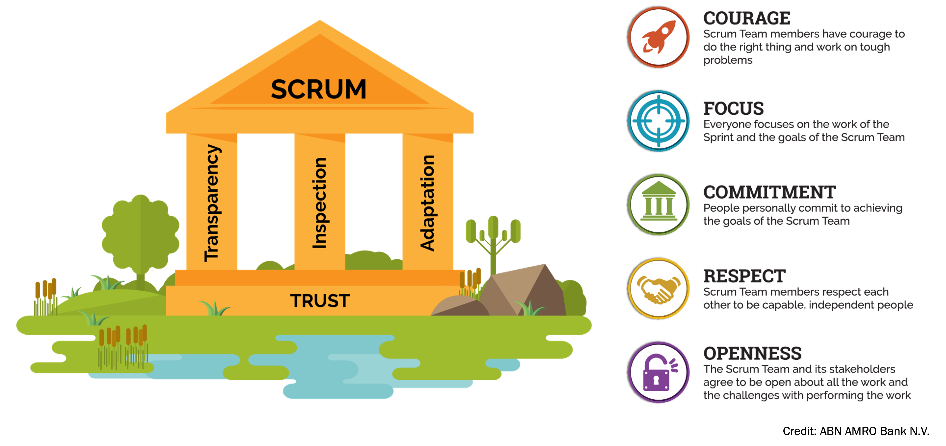
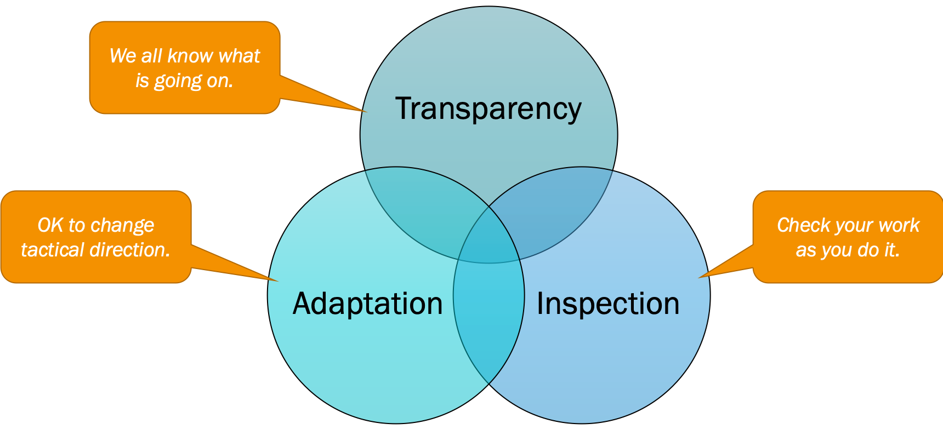
Scrum pillars
شفافیت یا Transparency ایجاد دید روشن برای افرادی که در به وجود آمدن نتیجه مسئول هستند.
بازرسی یا Inspection بررسی مستمر اینکه در حال انجام چه کاری با توجه به اهداف هستید.
انطباق یا Adaptation تغییر فرآیند‌های تیم به منظور کاهش خطاها.

Slide 11
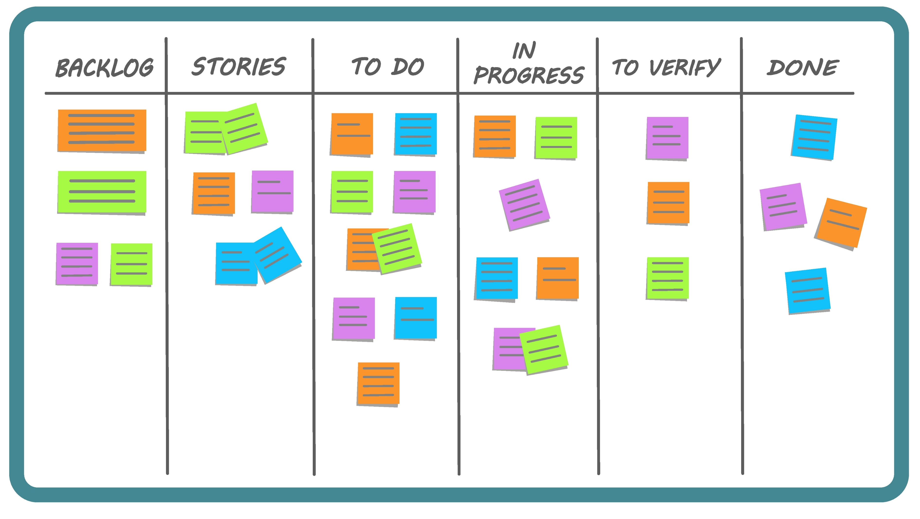
Scrum Board

Slide 12
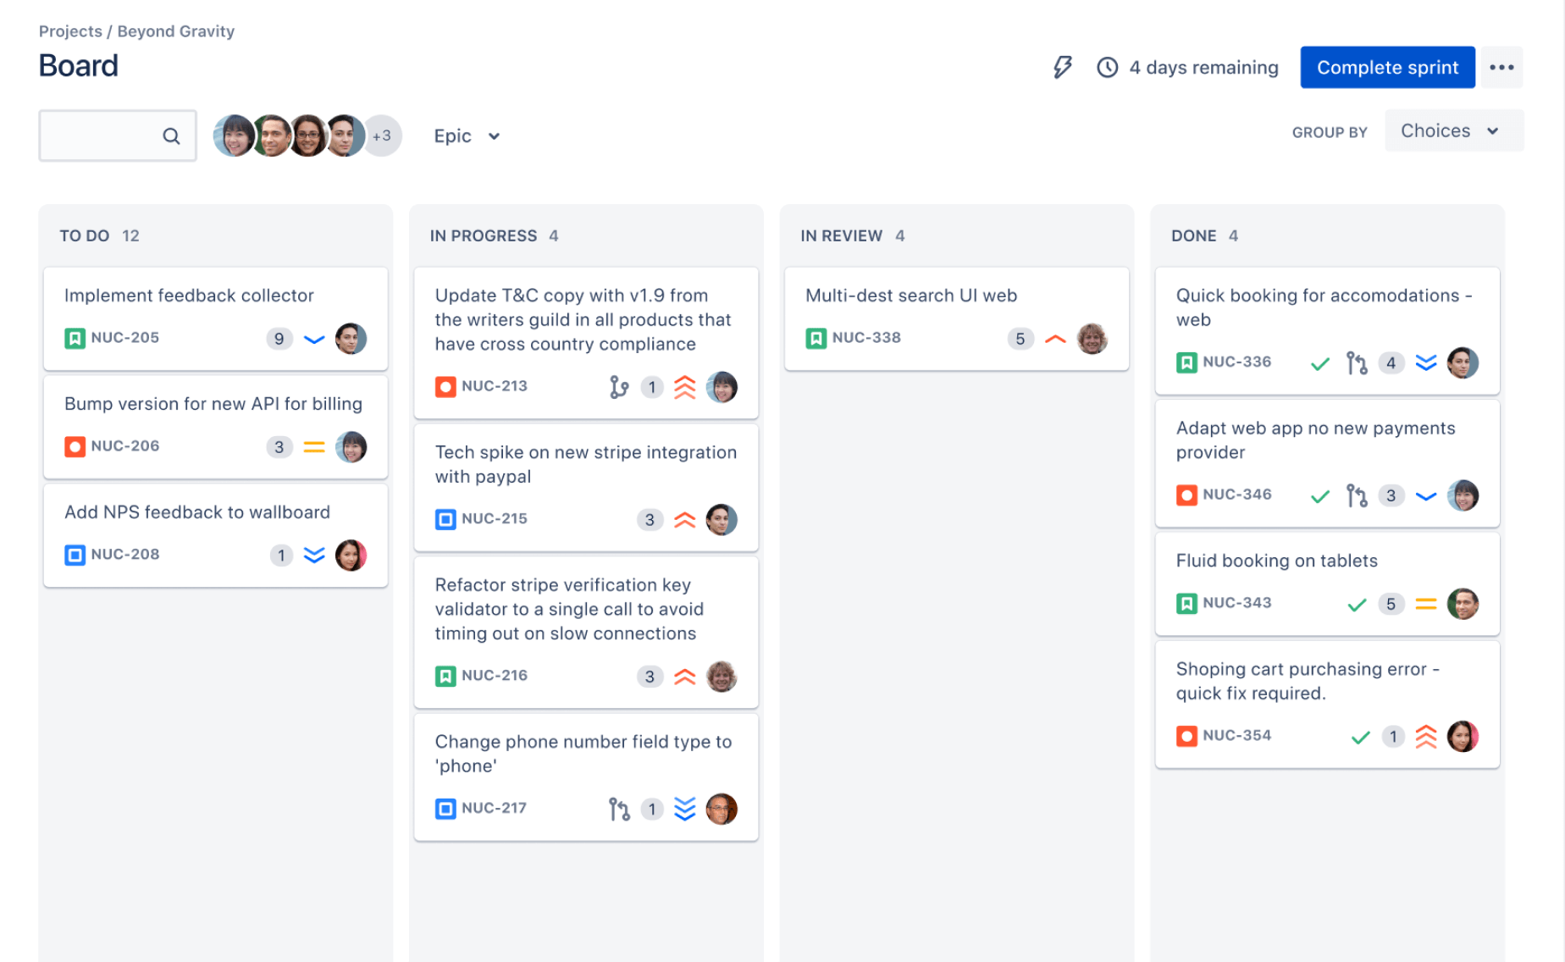
jira

Slide 13
The End

